Slide 1

BLOCKCHAIN INTEGRATED SECURITY FRAMEWORK FOR NETWORK TRAFFIC CLASSIFICATION
Advanced Deep Learning Based Intrusion Detection System
Zulqarnain Ali, Amanullah, Hanzla Ahmad Khan, Yousuf Kaleem
Department of Data Science Computing Faculty Islamia University of Bahawalpur
8th Semester - Information Security | Instructor: Dr. Faheem Bajwa
May 2026

Slide 2

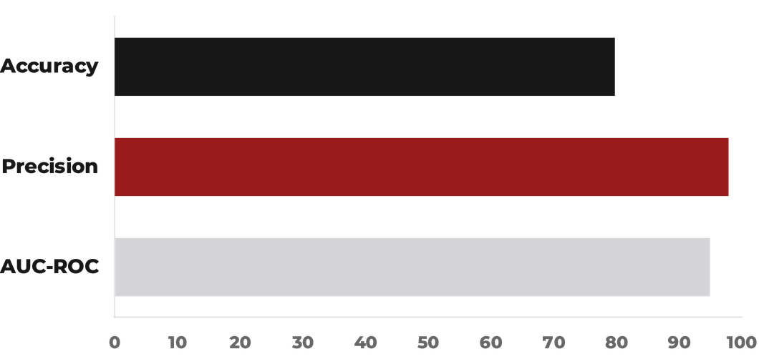
01
PROJECT OVERVIEW
CORE OBJECTIVES
DATASET: NSL-KDD
Develop a practical IDS integrating Deep Learning with Blockchain security.
125K+
41
23
Train Samples
Features
Attack Types
Achieve high classification accuracy with explainable forensic results.
PERFORMANCE SNAPSHOT
KEY TECHNOLOGIES
Bi-LSTM: Temporal traffic analysis.
SHA-256: Immutable blockchain logging.
TensorFlow 2.x: Model implementation.

Slide 3











02
PROBLEM STATEMENT & MOTIVATION
CURRENT CHALLENGES
PROPOSED SOLUTION
Evolving Attack Patterns
Bidirectional LSTM
Traditional IDS fail to detect novel, sophisticated zero-day threats.
Superior temporal analysis for deep contextual traffic understanding.
Alert Fatigue
Blockchain Integration
High false positive rates desensitize security analysts to real threats.
SHA-256 hashing for verifiable and tamper-proof security logging.
Auditability Gaps
Class Weighting
Lack of secure, immutable audit trails for forensic investigations.
Effective handling of imbalanced datasets for robust detection.
NETWORK TRAFFIC
BI-LSTM DETECTION
ATTACK CLASSIFICATION
BLOCKCHAIN LOG

Slide 4



03
SYSTEM ARCHITECTURE
MODEL ARCHITECTURE
TRAINING CONFIGURATION
BLOCKCHAIN INTEGRATION
Total Parameters
328,705
Hardware
GPU Accelerated
Algorithm
SHA-256
Bi-LSTM Layers
3
Epochs
19
Blocks Created
301
Dropout Rate
0.2
Training Time
200.13s
Chain Validity
100%
Regularization
L2 + Batch Norm
Learning Rate
0.001
Logging
Immutable
Optimization
Early Stopping
DATA PIPELINE
1
StandardScaler Normalization
2
Label Encoding (Categorical)
Each detected intrusion triggers a cryptographic hash, ensuring that security logs remain tamper-proof for forensic auditing.
3
Class Weighting (1.07 Attack)

Slide 5

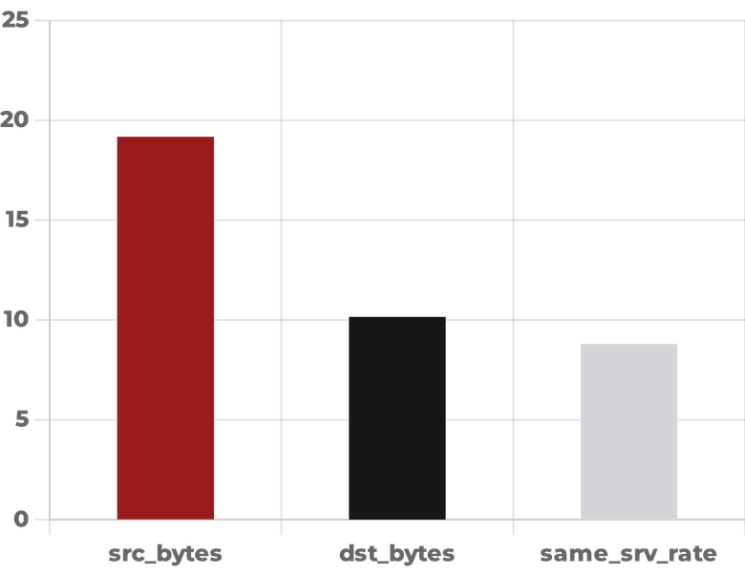

04
RESULTS & PERFORMANCE ANALYSIS
QUANTITATIVE METRICS
TOP FEATURE IMPORTANCE
BLOCKCHAIN ALERTS
ACCURACY
79.68%
285
CRITICAL
PRECISION
97.80%
RECALL
65.78%
HIGH
5
F1-SCORE
78.66%
AUC-ROC
94.87%
MEDIUM
4
AUC-PR
96.16%
MCC
0.6502
LOW
6
Analysis reveals that src_bytes and dst_bytes are the primary indicators for traffic classification, representing nearly 30% of model influence.

Slide 6
05
KEY FINDINGS & INSIGHTS
TECHNICAL ACHIEVEMENTS
PERFORMANCE INSIGHTS
Contextual Understanding: Bidirectional processing enhances temporal dependency recognition in traffic.
Precision (97.8%): Crucial for reducing alert fatigue and improving operational efficiency.
Tamper-Proof Auditing: Blockchain provides an immutable, verifiable trail for all security incidents.
Discrimination: Excellent AUC scores (94.87%) confirm strong ability to distinguish anomalies.
Robustness: Effective class weighting ensures reliability across diverse attack scenarios.
Viability: Fast training times demonstrate practical deployability in real-world environments.
ATTACK DETECTION ANALYSIS
SECURITY BENEFITS
Prevalent Attacks: Neptune attacks identified as most common (32.72%) in the dataset.
Immutable Logs: Ensures integrity and trustworthiness of security event records.
Predictive Features: Network-specific features proved most predictive for intrusion detection.
Compliance: Supports adherence to data integrity and auditability requirements.
Temporal Significance: Temporal patterns are critical for identifying sophisticated attacks.
Forensic Support: Facilitates detailed post-incident analysis and investigations.

Slide 7




06
PROJECT CONTRIBUTIONS & IMPACT
TECHNICAL
ACADEMIC
PRACTICAL
Integrated System: Functional Bi-LSTM model with blockchain logging.
•
IDS Advancement: Contributes to LSTM-based intrusion detection research.
•
Enterprise Security: Proactive threat detection for corporate networks.
•
Benchmarking: Robust evaluation framework with detailed metrics.
•
Blockchain Paradigm: Demonstrates benefits of hybrid security architectures.
•
Financial Fraud: Detection of fraudulent transactions in banking.
•
Feature Analysis: Ranked importance of 41 network features.
•
Reproducibility: Provides a baseline for future hybrid IDS studies.
•
Critical Infrastructure: Protection of vital systems against cyber threats.
•
Security Framework: Novel tamper-proof alert logging system.
•
Real-world Solutions: Addresses deployment challenges in network security.
•
Compliance: Aids in meeting data integrity and audit requirements.
•
FUTURE RESEARCH DIRECTIONS
Real-time Optimization
Multi-dataset Validation
Federated Learning

Slide 8
08
CONCLUSION & FUTURE WORK
PROJECT SUMMARY
KEY LESSONS
FUTURE DIRECTIONS
Successfully engineered a novel IDS with 79.68% accuracy and 97.8% precision.
Bi-directional processing is critical for capturing temporal attack context.
Real-time stream processing for instantaneous threat detection.
Integrated SHA-256 blockchain for immutable, tamper-proof security logging.
Blockchain adds minimal overhead while significantly enhancing auditability.
Investigation of Transformer-based architectures for improved modeling.
Class weighting is essential for robust performance on imbalanced datasets.
Federated Learning for privacy-preserving collaborative intelligence.
Demonstrated practical deployment readiness for enterprise network environments.
ACKNOWLEDGMENTS Special thanks to Dr. Faheem Bajwa for guidance and mentorship throughout this research project.
ISLAMIA UNIVERSITY OF BAHAWALPUR

